Slide 1
Creating Cloud Infrastructure with C# and Pulumi
Jake Adams

Slide 2
Outline
What
Why
How / Demos
Create cloud resources with Pulumi
Create dependent resources
Leverage strength of C# to create infrastructure
Stacks and configuration
Creating reusable building blocks (components and packages)
Importing manual or outside changes
Working with Pulumi infrastructure from other teams
Specialized setup (commands)
Multi-cloud

Slide 3
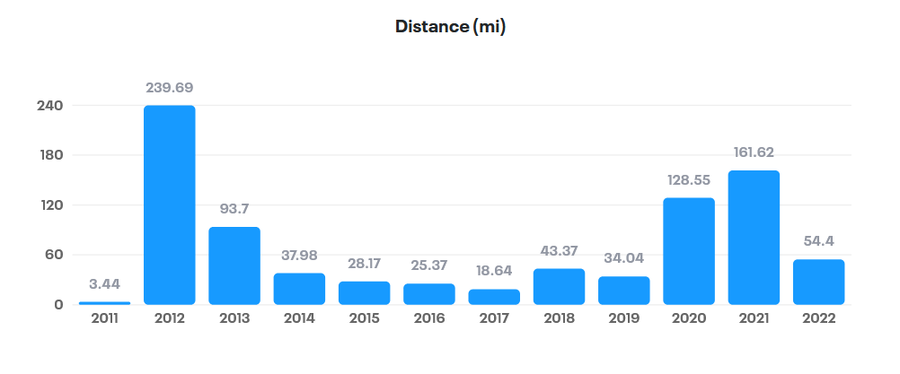
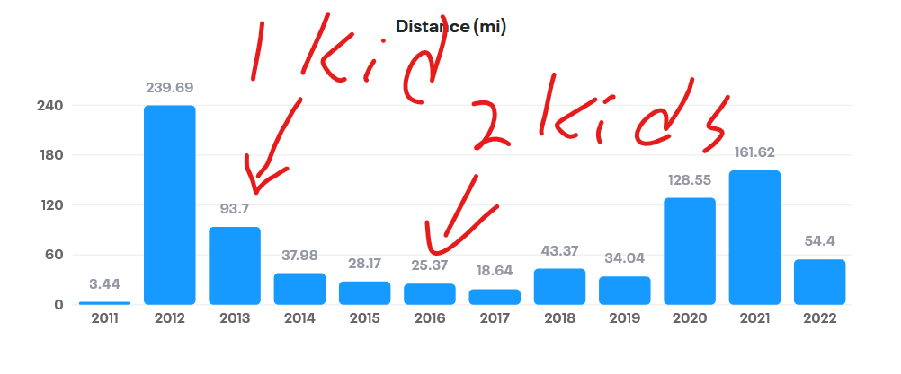
About Me
Jake Adams
Enterprise Architect
World Wide Technology
Twitter - @jacobladams
GitHub – github.com/jacobladams
Email – jacobladams@gmail.com

Slide 4

What is Pulumi?

Slide 5

WTF is ?
“Build, deploy, and manage modern cloud applications and infrastructure using familiar languages, tools, and engineering practices.” - Pulumi.com

Slide 6


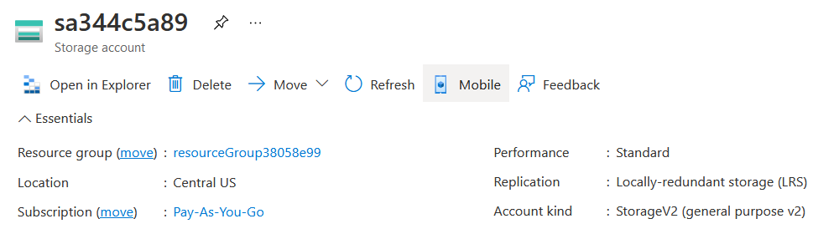
WTF is ?
var resourceGroup = new
ResourceGroup("resourceGroup");
var storageAccount =
new StorageAccount("sa",
new StorageAccountArgs
{
ResourceGroupName =
resourceGroup.Name,
Sku = new SkuArgs
{
Name = SkuName.Standard_LRS
},
Kind = Kind.StorageV2
});

Slide 7










WTF is ?
Cloud Providers | Languages
And countless others

Slide 8

Why?

Slide 9
Why Infrastructure as Code
Code
Written documentation
Build reusable block, abstract away complex concepts
Source Control
History
Enable Collaboration
Change log
Automation
Repeatable , less error prone
Quicker
Have everything in case it's destroyed
Don’t have to worry as much about backups

Slide 10






Comparison
 |  | Manual (ClickOps) |  | Azure CLI | Bicep
Repeatable
Declarative
Multi-cloud
General purpose language
Human readable

Slide 11
Tradeoffs
Defining your infrastructure in C# means … your infrastructure is defined in C#.
Smaller ecosystem
Delay in feature releases (Pulumi “native” packages)

Slide 12

DEMOS
He’s finally getting to the code!

Slide 13





Three Tier Demo
Blazor WebAssembly
Azure Functions
Cosmos DB
Azure Storage Account Static Website

Slide 14
Bonus – (Hand waving portion)
Packages
Commands
CI/CD
Mulicloud

Slide 15



Learn more / Questions
Pulumi.com
/learn
/docs
/registry
/resources

